Slide 1
ML Presentation: Steam Review Sentiment Analysis
Created by Filip Droca and Connor Booth

Slide 2

Introduction
Steam is an online video game retailer that has become the main way for many people to purchase games and software reliably for their computer.
Products listed on steam are able to be reviewed by users who purchase them, and they are displayed publicly on the products page.

Slide 3
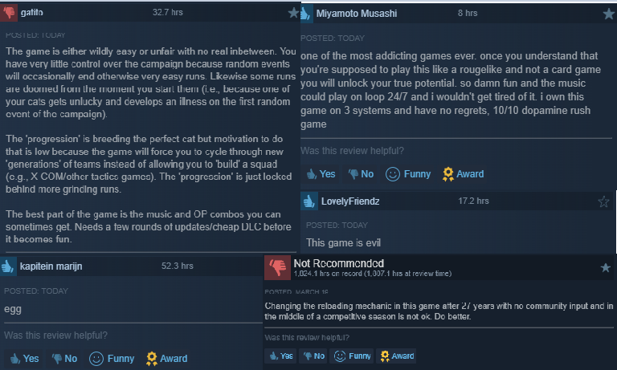
Steam’s Review Culture
As a developer, reviews are the gateway to understanding the perception of your released product.
While a majority of products on Steam receive a rating of Positive, the negative reviews are often much more telling.

Slide 4
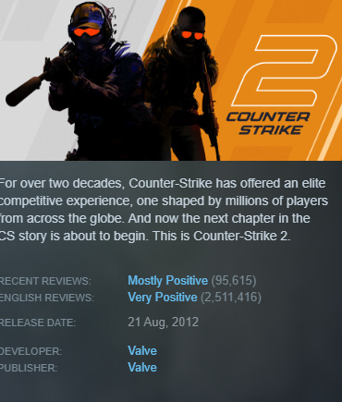

Problem: No internal predictions on sentiment.
Steam’s product scores are aggregates. They are purely the ratio of positive to negative reviews.
There is are no mechanisms to analyze review content or behavioural patterns.
As such, developers miss out on derived scalable, automated insight from this data.

Slide 5
Project Goals
Primary Objective: Develop scalable models capable of accurately predicting player sentiment by analyzing review metadata and text.
Additional goals:
Address the positive-bias of the platform to go beyond naive classification
Evaluate several models to find the best balance of interpretability and accuracy
To develop a pipeline capable of processing significant subsets of reviews while staying within local hardware limits.
To beat the necessary submission rate of ≥ 80% accuracy achieved.

Slide 6
Workload Split
Work was evenly distributed to whatever needed to get done, but generally:
Connor took focus on foundational preprocessing and feature engineering, and visualization
Filip took focus on model creation and tuning.

Slide 7
Preprocessing and Data Analysis

Slide 8
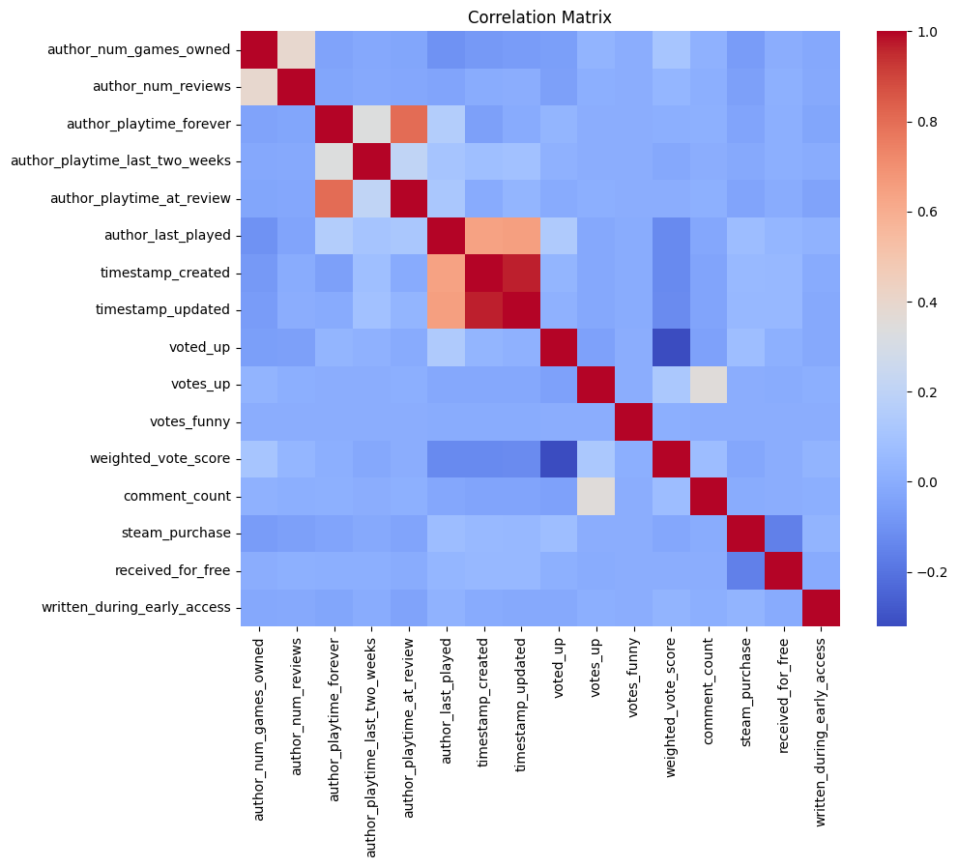
Data Collection & Exploratory Data Analysis
Data Collection:
Source: Kaggle
Downsampled 2 million English reviews, 70/30 positive/negative split
Originally 100+ million reviews, 84/16 positive/negative split
EDA:
Playtime, review length have heavy right skew

Slide 9
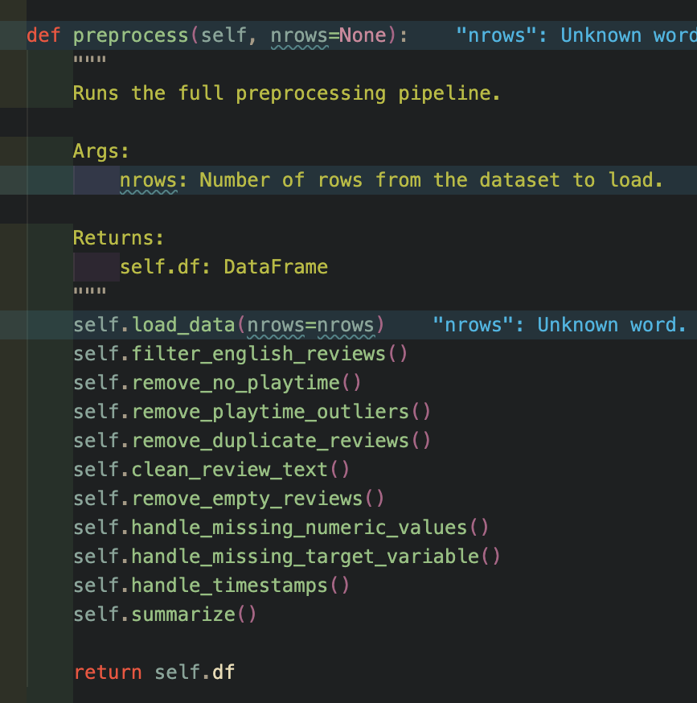
Preprocessing
Pipeline Steps:
Removed reviews with no plpaytime
Capped total playtime to 30,000 hours
Standardized review text
Engineered features for LR: playtime ratio, votes ratio, review length

Slide 10
Methodology

Slide 11
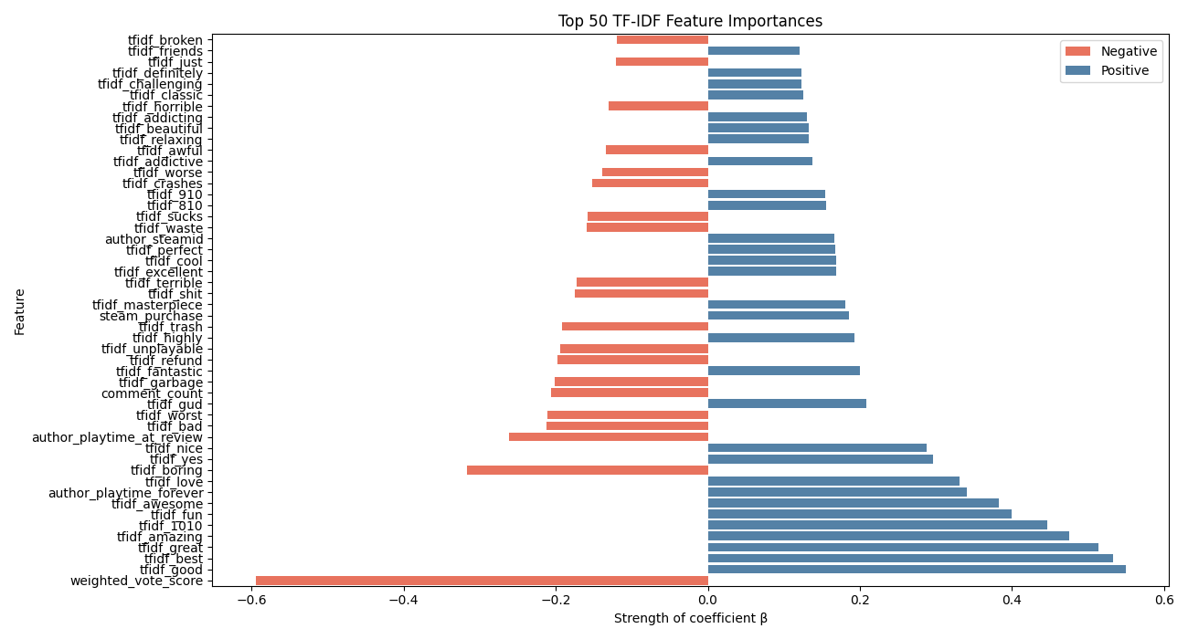
Logistic Regression & TF-IDF
The logistic regression model had two variants, a baseline and TF-IDF
Baseline:
16 features after tuning and feature engineering
StandardScaler to normalize features
TF-IDF:
1,000 text features appended to numeric features

Slide 12
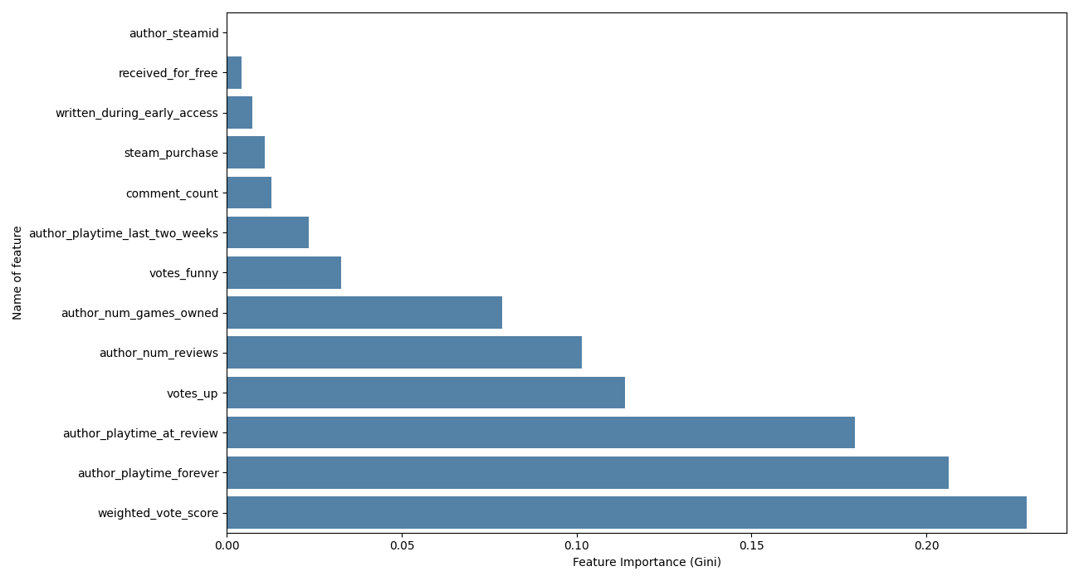
Random Forest
Trained on 13 features
No feature scaling required
100 estimators, no depth constraint
Hyperparameter tuning: RandomizedSearchCV, 3-fold CV
Parameters searched: n_estimators, max_depth, min_samples_split, max_features

Slide 13
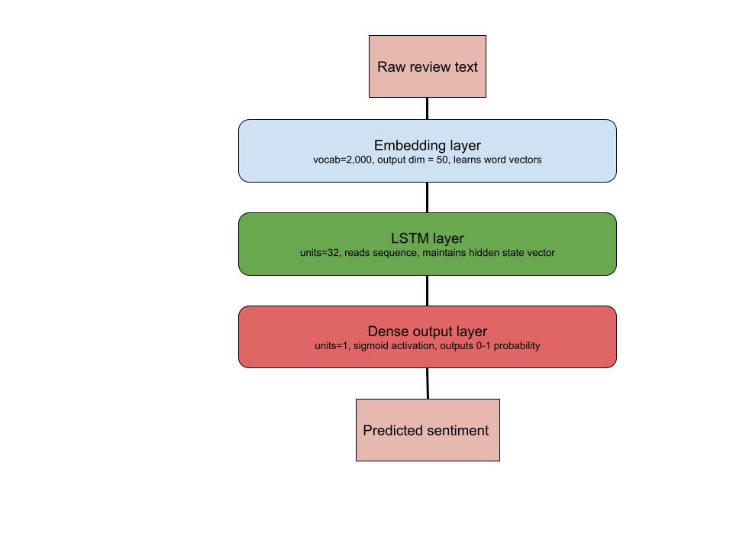
Long Short Term Memory (LSTM)
Sequential model, understands context (“not good” vs “good”)
No pretrained embeddings
Embedding dim = 50, lstm units = 32, dense
Vocabulary: 2,000 words, sequence padded to 100 tokens
Custom random search for tuning

Slide 14
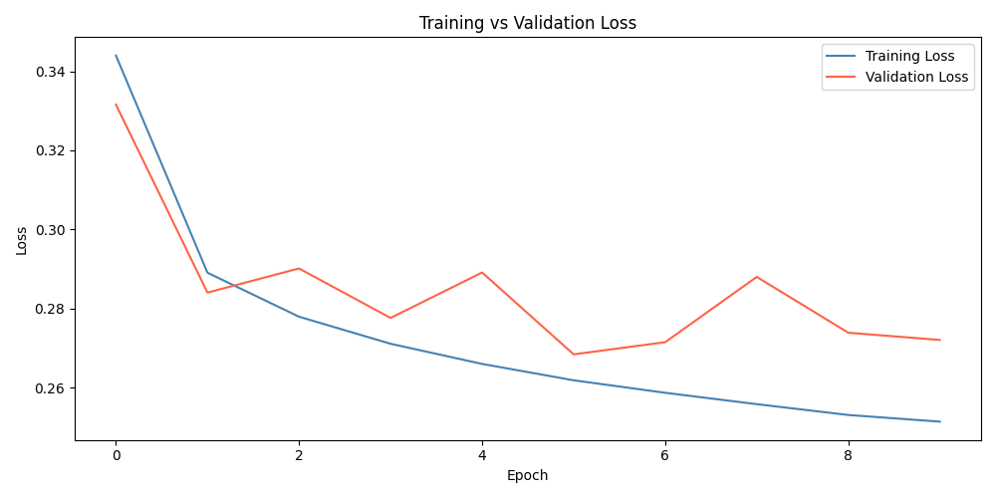
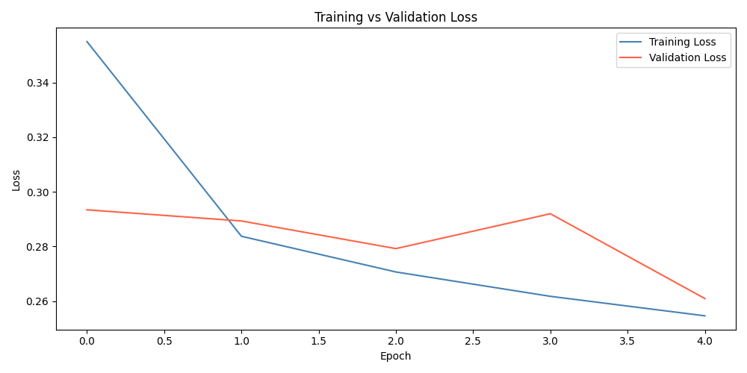
LSTM Visualizations
Base Model
Tuned Model

Slide 15
Results

Slide 16
Evaluation Metrics
Due to the nature of the problem and data, appropriate classification metrics were employed to test model performance.
Accuracy
Precision/Specificity
Recall/Sensitivity
F1-Score
Regression based statistics, such as MSE and RMSE, were inappropriate for model evaluation.

Slide 17
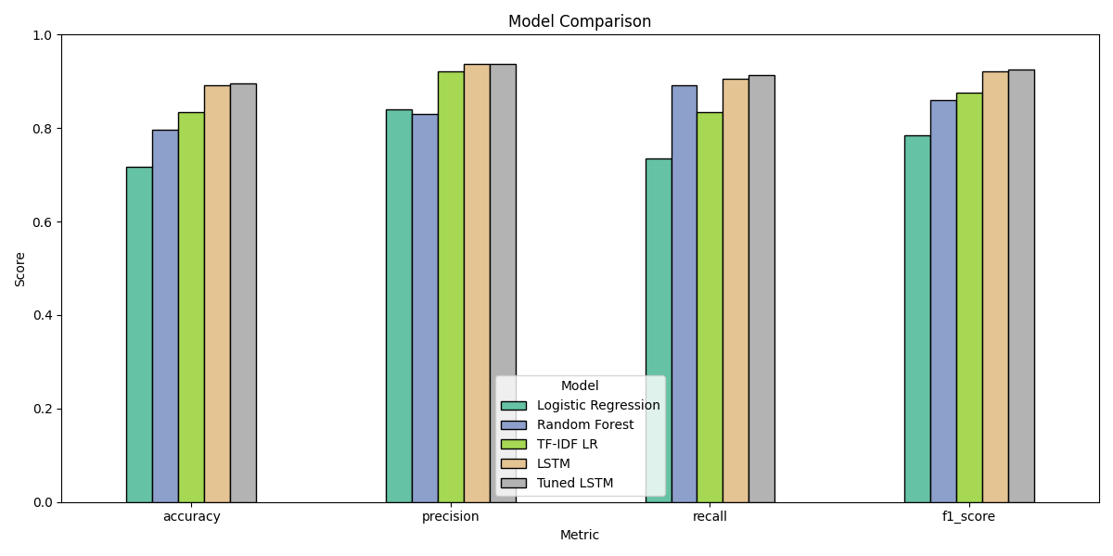
Comparative Model Analysis

Slide 18
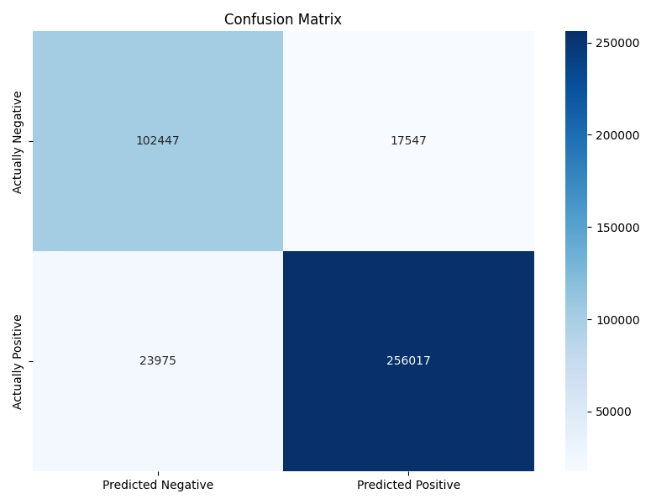
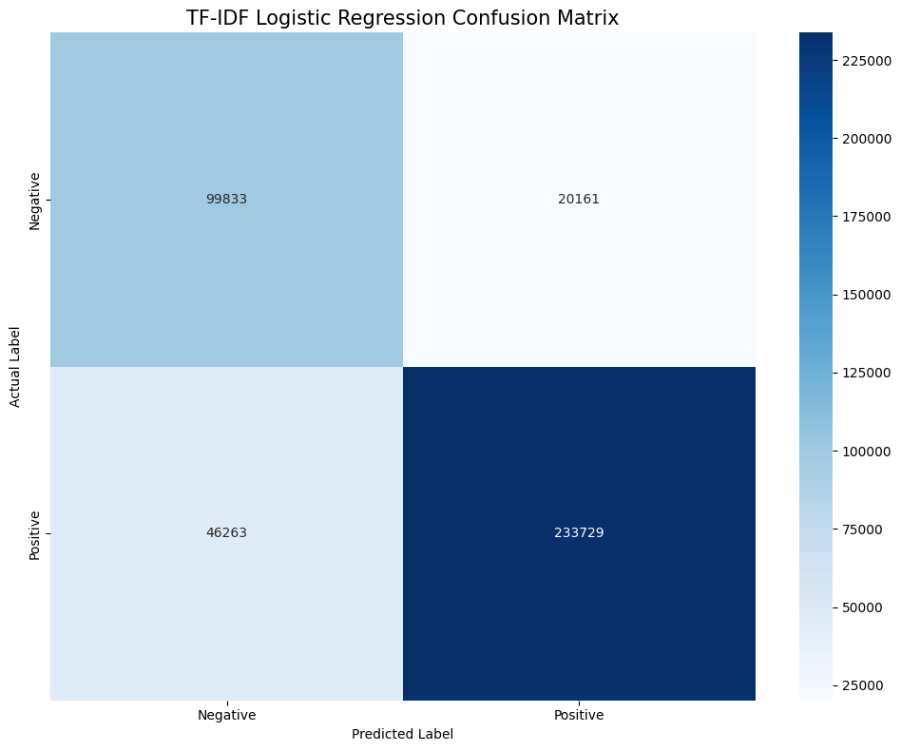
Tuned LSTM
TF-IDF LR

Slide 19
Feature Significance
While the naive models weighted playtime metadata as some of the strongest predictors, them underperforming compared to models utilizing text based features shows a reviewer’s voice is more indicative of their sentiment.

Slide 20
Conclusion

Slide 21
Findings
Linguistic characteristics of reviews significantly outperformed behavioural metadata, proving to be more reliable for signalling sentiment.
Nuance detection proved to be the deciding factor between the two most successful models, with TF-IDF Logistic Regression losing on accuracy due its inability to retrieve context.
The accuracy requirement was met on both linguistic characteristic models, while failing to be met on the metadata models.
The data pipeline established was capable of distilling the initial “Big Data” set down into an actionable subset that could run on local hardware.
Both models that safely beat the accuracy metric contained extreme computing needs. TF-IDF required managing memory requirements due to its sheer number of features and calculations, while LSTM models stretched the compute requirements.

Slide 22
Mistakes and Challenges
Local Environment:
The need to perform on local hardware made hyperparameter tuning and feature construction far more limited. Running on stronger machines with more processing power would produce better models than the ones created. GPU access would also improve training times.
Inherent linguistic noise:
Steam reviews are mixed bag and not standardized. As such, non-standard
reviews likely increased the error rate.
LSTM Early Dropout:
LSTM models are very prone to overfitting. While our hyperparameters avoided it
by choosing the model with a lower epoch count, early dropout would have guaranteed it
to generalize better to new data.

Slide 23
Future Considerations
With a model capable of predicting review sentiment, extensions for this project could include:
Temporal clustering to gauge sentiment of major patches and releases
Cross-genre generalizing
Aspect-based analysis to extend sentiment to sentiment type and topic
Extension to a full “Big Data” pipeline and dashboard

Slide 24
Thank you.

